Slide 1
CSE 207: Data Structures and Algorithms-II (Part 1)
Instructor
Dr Md Monirul Islam

Slide 2
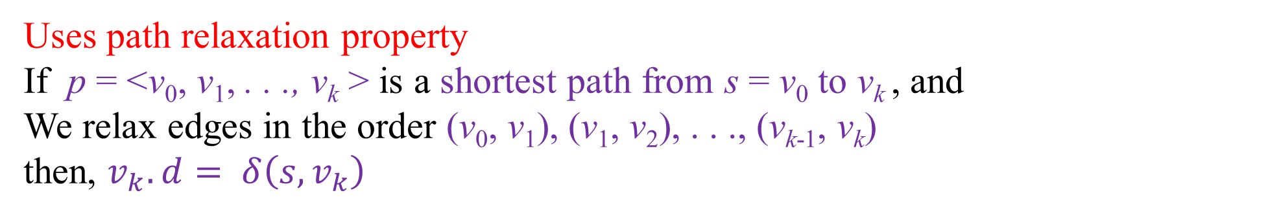
SSSP for DAG
Uses path relaxation property
If p = <v₀, v₁, . . ., v_{k} > is a shortest path from s = v₀ to v_{k} , and
We relax edges in the order (v₀, v₁), (v₁, v₂), . . ., (v_{k-1}, v_{k})
then, $v_{k}.d= δ\left(s,v_{k}\right)$
v₀
v₁
v₂
v₃
v_{k-1}
v_{k}
0
0
0
0
0
0
Relaxation
Step 1
Relaxation
Step 2
Relaxation
Step 3
Relaxation
Step k

Slide 3
SSSP for DAG
NOTE that if p = <v₀, v₁, . . ., v_{k} > is a shortest path from s = v₀ to v_{k} ,
then,
<v₀, v₁, . . ., v_{k-1} > is also a shortest path
<v₀, v₁, . . ., v_{k-2} > is also a shortest path
.
.
.
<v₀, v₁, v₂ > is also a shortest path
<v₀, v₁> is also a shortest path

Slide 4
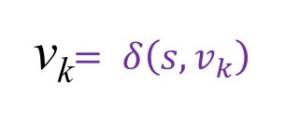
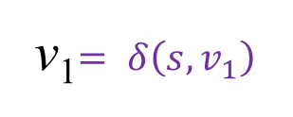
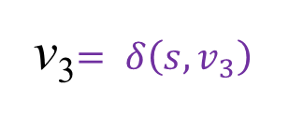

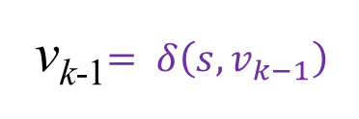
SSSP for DAG
Uses path relaxation property
If p = <v₀, v₁, . . ., v_{k} > is a shortest path from s = v₀ to v_{k} , and
We relax edges in the order (v₀, v₁), (v₁, v₂), . . ., (v_{k-1}, v_{k})
then, $v_{k}.d= δ\left(s,v_{k}\right)$
v₂$= δ\left(s,v_{2}\right)$
v_{k-1}$= δ\left(s,v_{k−1}\right)$
v₀
v_{k}$= δ\left(s,v_{k}\right)$
v₁$= δ\left(s,v_{1}\right)$
v₃$= δ\left(s,v_{3}\right)$
0
0
0
0
0
0
Relaxation
Step 1
Relaxation
Step 2
Relaxation
Step 3
Relaxation
Step k

Slide 5
SSSP for DAG
t
x
Vertices maintain an order
Edges move in a particular direction
Topological sorting finds the both
r
3
7
9
0
3
5
2
6
2
-1
0
4
1
s
3
5
11
-2
z
y
A DAG

Slide 6
SSSP for DAG
t
x
r
3
7
9
0
3
6
1
5
2
Topological
sorting
r
s
t
x
y
z
5
2
7
-1
-2
6
2
-1
0
3
0
0
3
0
0
4
1
s
3
4
3
2
5
11
-2
z
y
A DAG

Slide 7
SSSP for DAG
t
x
r
3
7
9
0
3
6
1
5
2
Topological
sorting
r
s
t
x
y
z
5
2
7
-1
-2
6
2
-1
0
3
0
0
3
0
0
4
1
s
3
4
3
2
5
11
-2
z
If we relax the edges just once in this order, we satisfy the path relaxation property for all v.
y
A DAG

Slide 8
SSSP for DAG
t
x
r
3
7
9
0
3
6
1
5
2
Topological
sorting
r
s
t
x
y
z
5
2
7
-1
-2
6
2
-1
0
3
0
0
3
0
0
4
1
s
3
4
3
2
5
11
-2
z
y
A DAG
Negative-weight edges are allowed
We need one pass over vertices
While processing a vertex, its out going edges are relaxed

Slide 9
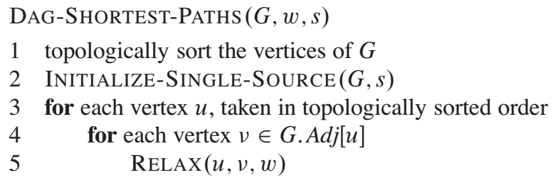
SSSP for DAG
Negative-weight edges are allowed
We need one pass over vertices
While processing a vertex, its out going edges are relaxed

Slide 10
Simulation of SSSP for DAG
6
1
r
s
t
x
y
z
5
2
7
-1
-2
∞
0
∞
∞
∞
∞
3
4
2
Initialization

Slide 11
Simulation of SSSP for DAG
6
1
6
1
r
s
t
x
y
z
r
s
t
x
y
z
5
2
7
-1
-2
5
2
7
-1
-2
∞
0
∞
∞
∞
∞
∞
0
∞
∞
∞
∞
3
4
3
4
2
2
Initialization
Step 1

Slide 12
Simulation of SSSP for DAG
6
1
6
1
r
s
t
x
y
z
r
s
t
x
y
z
5
2
7
-1
-2
5
2
7
-1
-2
∞
0
∞
∞
∞
∞
∞
0
∞
∞
∞
∞
3
4
3
4
2
2
Initialization
Step 1
6
1
r
s
t
x
y
z
5
2
7
-1
-2
∞
0
2
6
∞
∞
3
4
2
Step 2

Slide 13
Simulation of SSSP for DAG
6
1
6
1
r
s
t
x
y
z
r
s
t
x
y
z
5
2
7
-1
-2
5
2
7
-1
-2
∞
0
∞
∞
∞
∞
∞
0
∞
∞
∞
∞
3
4
3
4
2
2
Initialization
Step 1
6
1
6
1
r
s
t
x
y
z
r
s
t
x
y
z
5
2
7
-1
-2
5
2
7
-1
-2
∞
0
2
6
∞
∞
∞
0
2
6
6
4
3
4
3
4
2
2
Step 2
Step 3

Slide 14
Simulation of SSSP for DAG
6
1
6
1
r
s
t
x
y
z
r
s
t
x
5
2
7
-1
-2
y
z
∞
0
2
6
5
2
7
-1
-2
6
4
∞
0
2
6
5
4
3
4
3
4
2
2
Step 3
Step 4

Slide 15
Simulation of SSSP for DAG
6
1
6
1
r
s
t
x
y
z
r
s
t
x
5
2
7
-1
-2
y
z
∞
0
2
6
5
2
7
-1
-2
6
4
∞
0
2
6
5
4
3
4
3
4
2
2
Step 3
Step 4
6
1
r
s
t
x
y
z
5
2
7
-1
-2
∞
0
2
6
5
3
3
4
2
Step 5

Slide 16
Simulation of SSSP for DAG
6
1
6
1
r
s
t
x
y
z
r
s
t
x
5
2
7
-1
-2
y
z
∞
0
2
6
5
2
7
-1
-2
6
4
∞
0
2
6
5
4
3
4
3
4
2
2
Step 3
Step 4
6
1
6
1
r
s
t
x
y
z
r
s
t
x
y
z
5
2
7
-1
-2
5
2
7
-1
-2
∞
0
2
6
5
3
∞
0
2
6
5
3
3
4
3
4
2
2
Step 5
Step 6

Slide 17
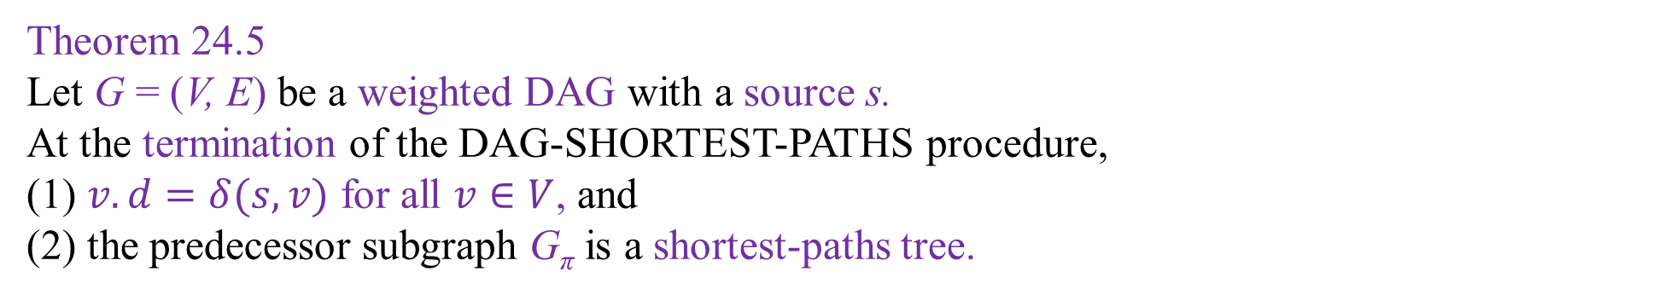
Correctness Theorem of SSSP Algorithm for DAG
Theorem 24.5
Let G = (V, E) be a weighted DAG with a source s.
At the termination of the DAG-SHORTEST-PATHS procedure,
(1) $v.d=δ(s,v)$ for all $v∈V$, and
(2) the predecessor subgraph G_{π} is a shortest-paths tree.

Slide 18
Correctness Theorem of SSSP Algorithm for DAG
Proof of Theorem 24.5
(1) $v.d=δ(s,v)$ for all $v∈V$
Two cases: no path from s to v
path exists from s to v

Slide 19
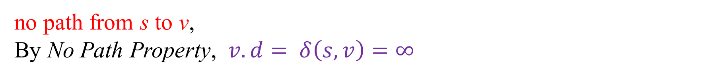
Correctness Theorem of SSSP Algorithm for DAG
Proof of Theorem 24.5
(1) $v.d=δ(s,v)$ for all $v∈V$
no path from s to v,
By No Path Property, $v.d= δ\left(s,v\right)=∞$
×
s
v
w
δ(s, v) = ∞
δ(s, w) = finite

Slide 20
Correctness Theorem of SSSP Algorithm for DAG
Proof of Theorem 24.5
(1) $v.d=δ(s,v)$ for all $v∈V$
Two cases: path exists from s to v
There is a shortest path p = <v₀, v₁, . . ., v_{k} > from s = v₀ to v = v_{k}
v₀
v₁
v₂
v₃
v_{k-1}
v_{k}
0
0
0
0
0
0

Slide 21
Correctness Theorem of SSSP Algorithm for DAG
Proof of Theorem 24.5
(1) $v.d=δ(s,v)$ for all $v∈V$
Two cases: path exists from s to v
We process vertices in topological order, and
relax edges in the order (v₀, v₁), (v₁, v₂), . . ., (v_{k-1}, v_{k})
v₀
v₁
v₂
v₃
v_{k-1}
v_{k}
0
0
0
0
0
0
Relaxation
Step 1
Relaxation
Step 2
Relaxation
Step 3
Relaxation
Step k

Slide 22
Correctness Theorem of SSSP Algorithm for DAG
Proof of Theorem 24.5
(1) $v.d=δ(s,v)$ for all $v∈V$
Two cases: path exists from s to v
Then, by path relaxation property, after termination $v_{i}.d= δ\left(s,v_{i}\right)$ for all V_{i}
v₀
v₁
v₂
v₃
v_{k-1}
v_{k}
0
0
0
0
0
0
Relaxation
Step 1
Relaxation
Step 2
Relaxation
Step 3
Relaxation
Step k

Slide 23
Correctness Theorem of SSSP Algorithm for DAG
Proof of Theorem 24.5
(2) the predecessor subgraph G_{π} is a shortest-paths tree.
We already proved in (1)$v.d= δ\left(s, v\right)$ for all v

Slide 24
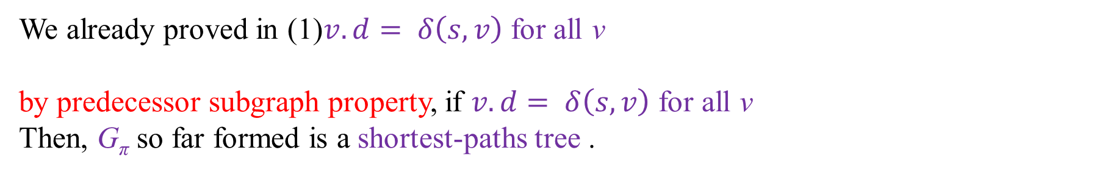
Correctness Theorem of SSSP Algorithm for DAG
Proof of Theorem 24.5
(2) the predecessor subgraph G_{π} is a shortest-paths tree.
We already proved in (1)$v.d= δ\left(s, v\right)$ for all v
by predecessor subgraph property, if $v.d= δ\left(s, v\right)$ for all v
Then, G_{π} so far formed is a shortest-paths tree .

Slide 25

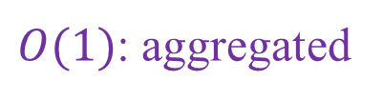
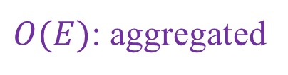


Complexity of SSSP for DAG
$$O(E+V)$$
$$O(V)$$
$$O(V)$$
$O(E)$: aggregated
$O(1)$: aggregated

Slide 26

Complexity of SSSP for DAG
$$O(E+V)$$
$$O(V)$$
$$O(V)$$
$O(E)$: aggregated
$O(1)$: aggregated
Total Time complexity: $O(E+V)$

Slide 27
Dijkstra Algorithm for SSSP
Edge weights must be non-negative: $w(u,v)≥0$
Cycle is allowed

Slide 28
Dijkstra Algorithm for SSSP
Maintains a S which contains vertices v whose v.d is finalized
Example, S = {s, y}
t
x
1
14
8
10
s
9
2
3
4
0
6
5
7
5
2
7
y
z

Slide 29
Dijkstra Algorithm for SSSP
Maintains a S which contains vertices v whose v.d is finalized
Example, S = {s, y}
From V-S, Algorithm chooses the vertex u with minimum u.d
Example, V- S = {t, x, z}
next u is z
Min-priority Queue is used to choose u
t
x
1
14
8
10
s
9
2
3
4
0
6
5
7
5
2
7
y
z

Slide 30
Dijkstra Algorithm for SSSP
Maintains a S which contains vertices v whose v.d is finalized
Example, S = {s, y}
From V-S, Algorithm chooses the vertex u with minimum u.d
Example, V- S = {t, x, z}
next u is z
All outgoing edges of u are relaxed
t
x
1
14
8
10
s
9
2
3
4
0
6
5
7
5
2
7
y
z

Slide 31
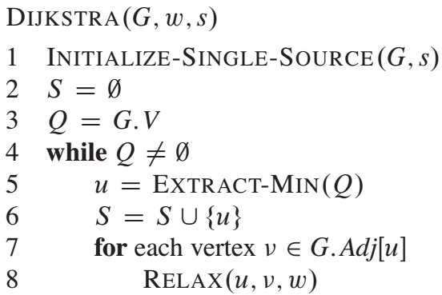
Dijkstra Algorithm for SSSP

Slide 32
Dijkstra Algorithm for SSSP
Very similar to Prim’s Algorithm or BFS
The algorithm maintains the invariant that Q = V-S at the start of each iteration of the while loop of lines 4-8.

Slide 33
Simulation of Dijkstra Algorithm
t
x
1
∞
∞
10
s
9
2
3
4
0
6
5
7
∞
2
∞
y
z
Initialization

Slide 34
Simulation of Dijkstra Algorithm
t
x
t
x
1
∞
10
1
∞
∞
10
10
s
s
9
9
2
3
2
3
4
4
6
0
6
0
7
5
7
5
∞
2
∞
5
2
∞
y
z
y
z
Initialization
Step 1

Slide 35
Simulation of Dijkstra Algorithm
t
x
t
x
t
x
1
∞
10
1
∞
8
1
14
∞
10
10
10
s
s
s
9
9
9
2
3
2
3
4
2
3
4
6
6
0
4
0
0
6
7
5
7
7
5
5
∞
2
∞
5
2
∞
5
2
7
y
z
y
z
y
z
Initialization
Step 1
Step 2

Slide 36
Simulation of Dijkstra Algorithm
t
x
t
x
8
1
14
8
1
13
10
10
s
s
9
9
2
3
2
3
4
4
0
6
0
6
7
5
7
5
5
2
7
5
2
7
y
z
y
z
Step 2
Step 3

Slide 37
Simulation of Dijkstra Algorithm
t
x
t
x
t
x
8
1
14
8
1
13
8
1
9
10
10
10
s
s
s
9
9
9
2
3
2
3
2
3
4
4
6
4
0
6
0
0
6
7
7
5
7
5
5
5
2
7
5
2
7
5
2
7
y
z
y
z
y
z
Step 2
Step 3
Step 4

Slide 38
Simulation of Dijkstra Algorithm
t
x
t
x
t
x
8
1
13
8
1
9
8
1
9
10
10
10
s
s
s
9
9
9
2
3
2
3
2
3
4
4
6
4
0
6
0
0
6
7
7
5
7
5
5
5
2
7
5
2
7
5
2
7
y
z
y
z
y
z
Step 3
Step 4
Step 5

Slide 39
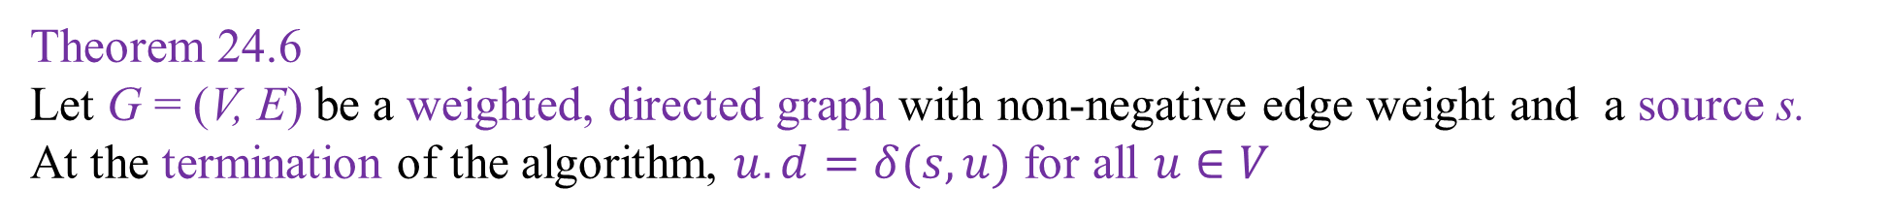
Correctness of Dijkstra Algorithm
Theorem 24.6
Let G = (V, E) be a weighted, directed graph with non-negative edge weight and a source s.
At the termination of the algorithm, $u.d=δ(s,u)$ for all $u∈V$

Slide 40
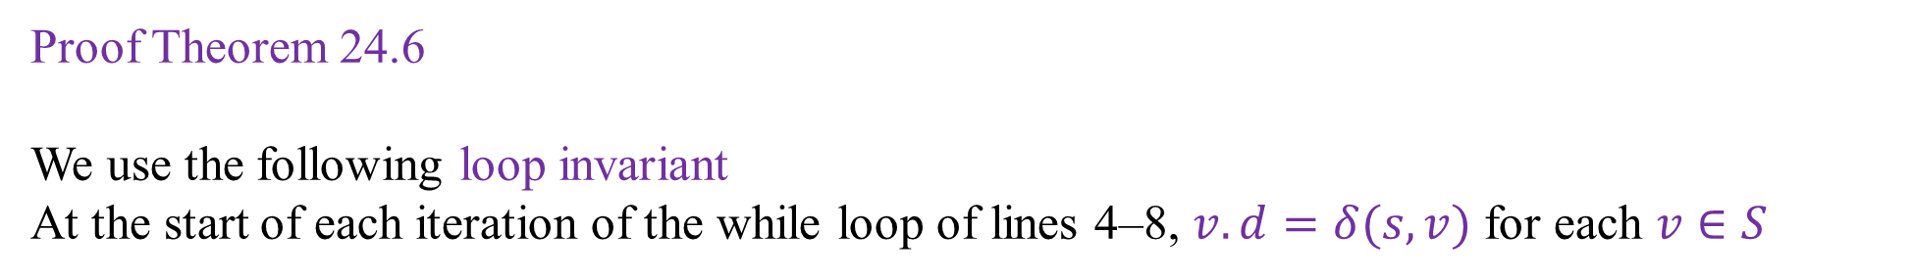
Correctness of Dijkstra Algorithm
Proof Theorem 24.6
We use the following loop invariant
At the start of each iteration of the while loop of lines 4–8, $v.d=δ(s,v)$ for each $v∈S$

Slide 41
Correctness of Dijkstra Algorithm
Proof Theorem 24.6
We use the following loop invariant
At the start of each iteration of the while loop of lines 4–8, $v.d=δ(s,v)$ for each $v∈S$
t
x
t
x
1
1
8
9
8
14
10
10
s
s
9
9
2
3
4
0
6
2
3
4
0
6
5
7
5
7
5
2
7
5
2
7
y
z
y
z
Intermediate
Final

Slide 42
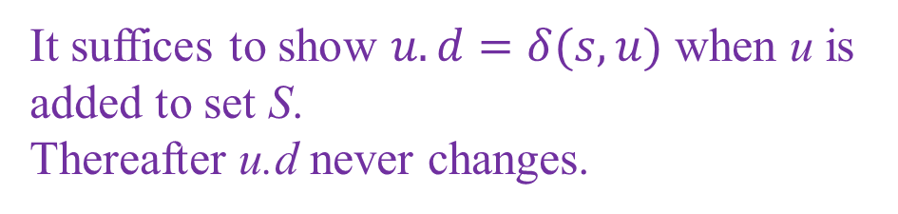
Correctness of Dijkstra Algorithm
Proof Theorem 24.6
We use the following loop invariant
At the start of each iteration of the while loop of lines 4–8, $v.d=δ(s,v)$ for each $v∈S$
t
x
1
14
8
It suffices to show $u.d=δ(s,u)$ when u is added to set S.
Thereafter u.d never changes.
10
s
9
2
3
4
0
6
5
7
5
2
7
y
z
Intermediate

Slide 43
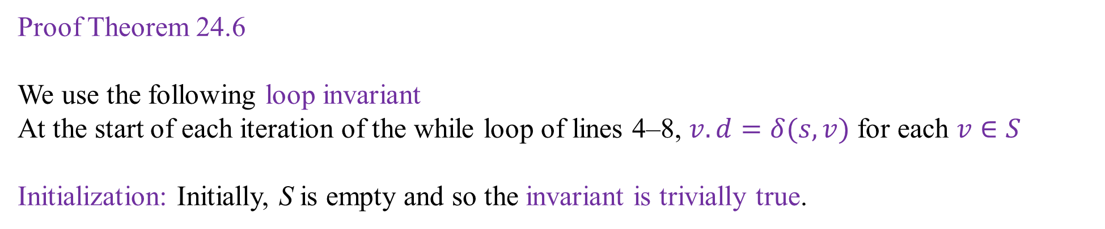
Correctness of Dijkstra Algorithm
Proof Theorem 24.6
We use the following loop invariant
At the start of each iteration of the while loop of lines 4–8, $v.d=δ(s,v)$ for each $v∈S$
Initialization: Initially, S is empty and so the invariant is trivially true.

Slide 44
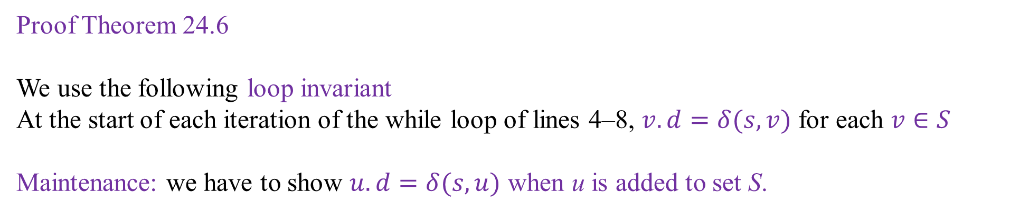
Correctness of Dijkstra Algorithm
Proof Theorem 24.6
We use the following loop invariant
At the start of each iteration of the while loop of lines 4–8, $v.d=δ(s,v)$ for each $v∈S$
Maintenance: we have to show $u.d=δ(s,u)$ when u is added to set S.

Slide 45
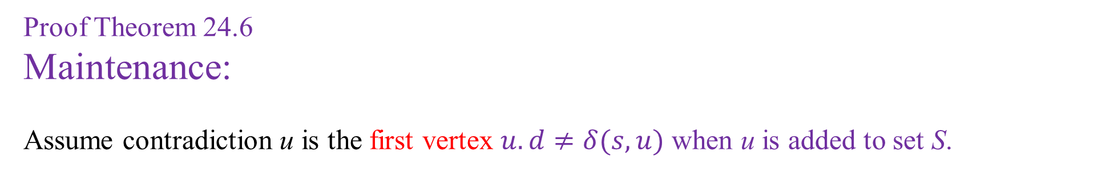
Correctness of Dijkstra Algorithm
Proof Theorem 24.6
Maintenance:
Assume contradiction u is the first vertex $u.d≠δ(s,u)$ when u is added to set S.

Slide 46
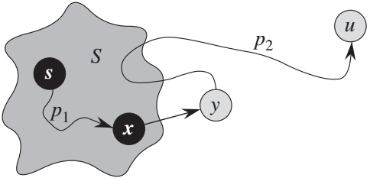
Correctness of Dijkstra Algorithm
Proof Theorem 24.6
Maintenance:
Assume contradiction u is the first vertex $u.d≠δ(s,u)$ when u is added to set S.
n
S
m

Slide 47
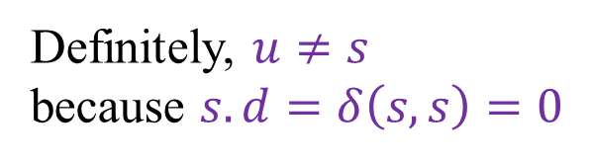
Correctness of Dijkstra Algorithm
Proof Theorem 24.6
Maintenance:
Assume contradiction u is the first vertex $u.d≠δ(s,u)$ when u is added to set S.
Definitely, $u≠s$
because $s.d=δ\left(s,s\right)=0$
n
S
m

Slide 48
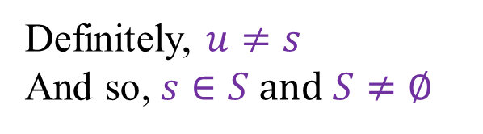
Correctness of Dijkstra Algorithm
Proof Theorem 24.6
Maintenance:
Assume contradiction u is the first vertex $u.d≠δ(s,u)$ when u is added to set S.
Definitely, $u≠s$
And so, $s∈S and S≠∅$
n
m

Slide 49
Correctness of Dijkstra Algorithm
Proof Theorem 24.6
Maintenance:
Assume contradiction u is the first vertex $u.d≠δ(s,u)$ when u is added to set S.
We must have a path from s to u
n
m

Slide 50
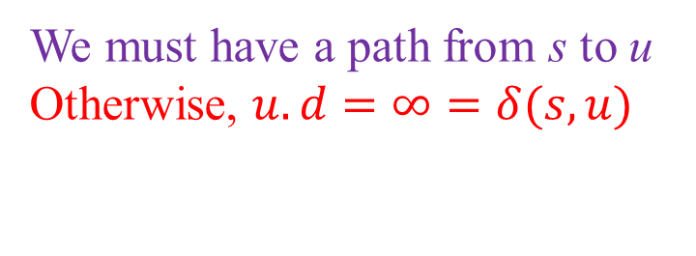
Correctness of Dijkstra Algorithm
Proof Theorem 24.6
Maintenance:
Assume contradiction u is the first vertex $u.d≠δ(s,u)$ when u is added to set S.
We must have a path from s to u
Otherwise, $u.d=∞=δ(s,u)$
n
m

Slide 51
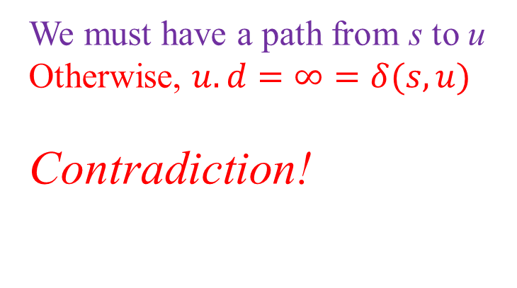
Correctness of Dijkstra Algorithm
Proof Theorem 24.6
Maintenance:
Assume contradiction u is the first vertex $u.d≠δ(s,u)$ when u is added to set S.
We must have a path from s to u
Otherwise, $u.d=∞=δ(s,u)$
Contradiction!
n
m

Slide 52
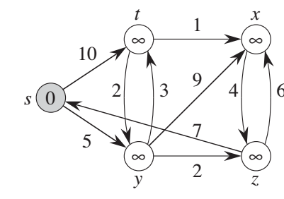
t
x
1
∞
∞
10
s
9
2
3
4
0
6
5
7
∞
2
∞
y
z
∞

Slide 53
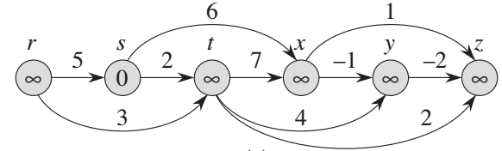
t
x
r
3
7
9
0
3
5
2
6
2
-1
0
4
1
s
3
6
1
r
s
t
x
y
z
5
11
5
2
7
-1
-2
-2
0
3
0
0
3
0
y
z
3
4
2

Slide 54
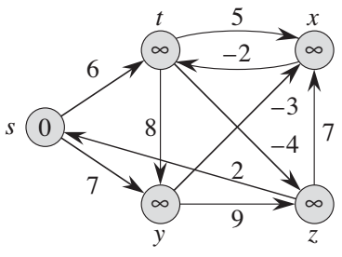
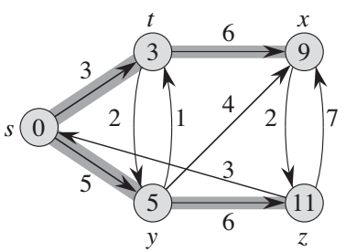
t
x
h
i
t
x
2
6
9
∞
∞
6
9
3
3
3
-8
3
3
s
∞
s
4
0
j
0
2
1
2
7
3
5
5
5
6
11
5
6
11
y
z
y
z

Slide 55
t
x
h
i
t
5
x
2
6
9
∞
∞
∞
3
∞
-2
3
-8
3
6
s
∞
s
8
-3
0
j
0
7
-4
2
5
7
5
6
11
∞
∞
9
y
z
y
z

Slide 56
End of Slides

Slide 57
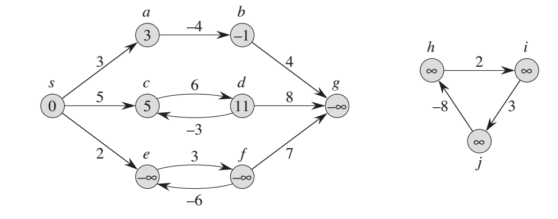
Negative Weight Edges

Slide 58
a
b
-4
-1
3
4
3
s
c
6
d
g
h
i
5
8
2
0
5
11
- ∞
∞
∞
-3
3
2
f
-8
e
3
7
∞
- ∞
- ∞
j
-6

Slide 59
a
b
-4
3
-1
4
3
s
c
6
d
g
h
i
5
8
∞
2
∞
0
5
11
- ∞
-3
3
-8
2
e
3
f
7
∞
- ∞
- ∞
j
-6

